Slide 1
JUNTA QUINCENAL
BALFER
10 DIC - 22 DIC

Slide 2
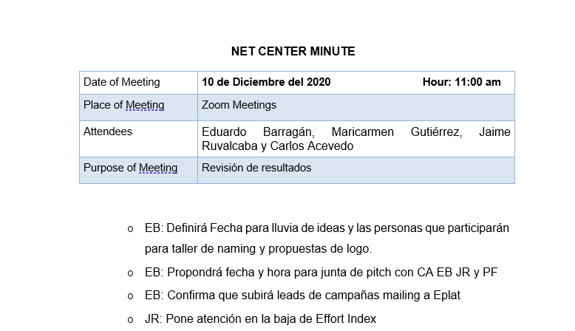

Slide 3
Resultados BALFER/AM-PVO/LEADS/11.20
 | Riviera Maya499/12.20 | Relacion-Vacaciones/12.20 | ANIVERSARIO | 399/NYSALE |  | ANIVERSARIO /1220 | AMAZING TRAVELERS CANCUN | TOTAL
Ad name | GIRL499/12.20 | Nuevo anuncio | Cancun-Couple | CHICA-399 | FAMILY-399 - | Cancun-Couple | Cancun-Couple
Clicks | 4537 | 2728 | 797 | 199 | 5 | 55 | 11 | 8332
% Conversion | 8.27% | 7.44% | 4.64% | 11.06% | 0.00% | 1.82% | 9.09% | 7.67%
Leads | 375 | 203 | 37 | 22 | 0 | 1 | 1 | 639
CPL | $1.73 | $2.73 | $4.22 | $1.58 |  | $10.86 | $6.13 | $2.21
Investment | $648.94 | $554.21 | $155.97 | $34.84 | $1.74 | $10.86 | $6.13 | $1,412.69

Slide 4
Resultados BALFER/AM-PVO/LEADS/SALE399
 | 399LOOKALIKE/12.20 |  | 399REMARKETING/12.20 |  | TOTAL
Ad name | PAREJA/12.2020 | HAMACA/12.2020 anuncio | FAMILY/12.2020 | COUPLE/12.2020
Clicks | 88 | 19 | 93 | 28 | 228
% Conversion | 9.09% | 10.53% | 8.60% | 3.57% | 8.33%
Leads | 8 | 2 | 8 | 1 | 19
CPL | $3.10 | $4.13 | $3.17 | $6.30 | $3.40
Investment | $24.78 | $8.25 | $25.35 | $6.30 | $64.68

Slide 5
Resultados
Balfer/AM-PVO/Leads/Sale/12.20
Resultados
Balfer/AM-PVO/Leads/Winter
 | XmasSale-Loading/12.20 | Winter Sale$499 | TOTAL
Ad name | XmasLoading/12.20 | Winter/Sillas
Clicks | 33 | 19 | 52
% Conversion | 6.06% | 5.26% | 5.77%
Leads | 2 | 1 | 3
CPL | $18.77 | $14.02 | $17.19
Investment | $37.54 | $14.02 | $51.56
 | WinterSale/hispanos/12.20 | WinterSale/12.20 | TOTAL
Ad name | PAREJA/12.2020 | FAMILY/12.2020
Clicks | 41 | 24 | 65
% Conversion | 4.88% | 4.17% | 4.62%
Leads | 2 | 1 | 3
CPL | $5.76 | $7.71 | $6.41
Investment | $11.51 | $7.71 | $19.22

Slide 6


PROPUESTAS DE LOGO

Slide 7


PROPUESTAS DE LOGO

Slide 8


PROPUESTAS DE LOGO

